Slide 1
Worcestershire Place: opportunities for the VCSE sector
Worcestershire VCSE Alliance Online Briefing
18th September 2024

Slide 2
Agenda
Herefordshire and Worcestershire Integrated Care System: Landscape, Priorities and Challenges
Integrated working update
Integrated Care
Neighbourhood Teams
Provider Collaboratives
Worcestershire Place Partnership
Next steps

Slide 3
Landscape, Priorities and Challenges

Slide 4
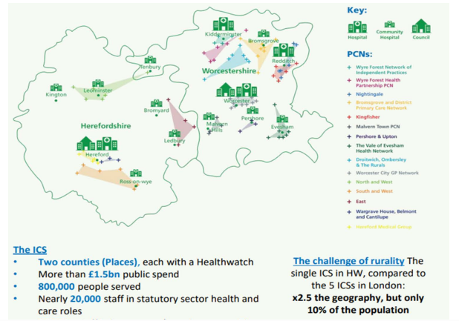
Herefordshire and Worcestershire Integrated Care System
Our Services
4 NHS Trusts (including WMAS)
2 Upper tier Local Authorities
6 District Councils (Worc)
15 Primary Care Networks
79 GP Practices
122 Community Pharmacies
96 Dentists
64 Optometrists
5 Hospices
Over 3000 VCSE organisations
1 Police Service
1 First and Rescue Service
1 Integrated Care Board

Slide 5
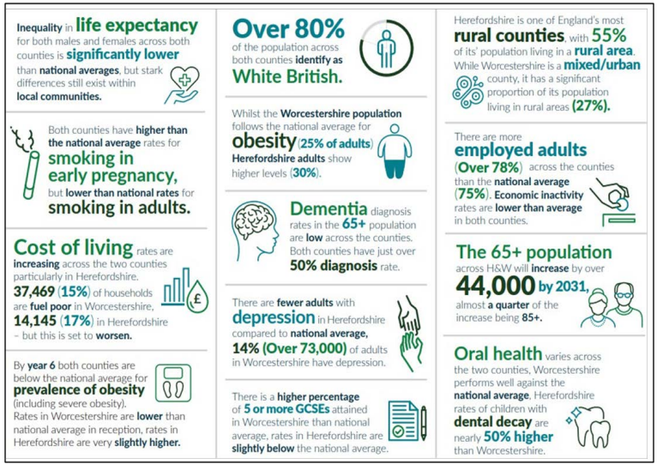
Herefordshire & Worcestershire Joint Strategic Needs Assessment 2023
Areas of concern
Health Inequalities persist Lower IMD groups experience higher levels of health inequity, demonstrated in decreased life expectancy and higher mortality rates particularly in CVD
Factors driving inequality Higher rates of smoking and excess weight, and lower rates of physical activity in more deprived groups, and pressures of fuel poverty
Children and Young People inequalities Significant number of children in Worcestershire are currently living in poverty. We also have rising numbers of vulnerable children and higher than England value of pupils with special educational needs.
Mental Health The COVID-19 pandemic and cost of living pressures have challenged mental health and wellbeing, coinciding with the largest drops in wellbeing recorded, although recent data indicated these have improved.

Slide 6
Key Integrated Care System challenges
Increasing demand for health and care services
The number of people aged 65+ in Worcestershire has increased by almost 27% since 2011
It is projected that there will be a population increase of circa 44,000 in Worcestershire by 2031, of which more than 25% will be over the age of 85.
The gap between life expectancy and healthy life expectancy means that people are living longer but in poorer health.
Financial stability and optimising use of health and care services
As a deficit financial system, there is a requirement for all system partners to implement stringent productivity, efficiency and savings programmes.
In Sept 2023, partners audited whether people were being cared for in the most appropriate care setting for their needs at the time. The study showed that just over 21.5% of the people reviewed across Worcestershire Place could have been cared for in a more appropriate care setting – if an optimal balance between capacity, demand and flow efficiency was achieved.
Strategic demand and capacity model work suggests that without change, the H&W ICS will require an additional 365 acute beds by 2033
Access to dental services
Inequitable levels of funding leading to workforce challenges in relation to recruitment and retention.
Inability to take on new patients due to inconsistent funding levels.

Slide 7
Integrated Care Strategy On A Page Good health and wellbeing for everyone
2023 - 2033
We have collectively developed a CLEAR VISION AND MISSION for integrated care across Herefordshire and Worcestershire for the next 10 years….
Improve outcomes in population health and healthcare
Tackle inequalities in outcomes, experience and access
Enhance productivity and value for money
Support broader social and economic development
Working together with people and communities to enable everybody to enjoy good physical and mental health and live independently for longer
1. Maximising the opportunity to work together as partners to build connections, share learning and address shared challenges in the short and long term
To deliver this, we need to make the following 8 COMMITMENTS for how we will integrate care…
2. Focusing on prevention, personalised care and taking action to address health inequalities and vulnerabilities.
3. Enhancing health and wellbeing by taking an integrated approach to areas such as housing, jobs, leisure and environment.
4. Supporting people and carers to take responsibility for their own and their families health and wellbeing and working to enable their independence.
5. Co-producing solutions with individuals, carers, our communities and Voluntary & community sector organisations as equal partners with collective responsibility.
6. Making the right service the easiest service to access and providing it as close to home as possible.
7. Delivering better value for money, stopping duplication and using population health management to be smarter in how we target interventions.
8. Using digital to make services more accessible and effective, but never forgetting the risks of digital exclusion.
Providing the best start in life
Living, ageing and dying well
Reducing ill health and premature deaths from avoidable causes
Our two Joint Strategic Needs Assessment’s clearly identify a number of key SHARED PRIORITIES for what we are seeking to improve
Eliminate smoking in pregnancy
Reduce infant mortality
More children who are a healthy weight
Improving oral health and reducing tooth decay
Increasing number of children who are school ready
Improve social, emotional and mental health & wellbeing
Support people to enjoy good mental health and wellbeing
Increasing physical activity and reducing unhealthy behaviours
Increasing timely diagnosis of dementia
Reducing inequality of health outcomes for people with learning disabilities & autism
Improving access to urgent care services
Improving access to primary and community-based services (inc pharmacy, optometry and dentistry)
Providing end of life care to enable patients to die with dignity
Delivery of the ICS commitment to carers
Improving targeted provision and uptake of primary, secondary and tertiary prevention services..
Proactively reducing inequalities in access, experience and outcomes
Providing timely cancer diagnosis and treatment
Reducing the risk of cardiovascular disease and improving stroke care
Reducing deaths by suicide
Core Priorities:
Every child has the best start in life
Good mental health throughout lifetime
Supported by 6 additional priorities, addressing the wider social determinants of health
Integrated with and aligned to the TWO JOINT LOCAL HEALTH AND WELLBEING STRATEGIES
Worcestershire Joint Local Health and Wellbeing Strategy
Herefordshire Joint Local Health and Wellbeing Strategy
Good mental health and wellbeing, supported by:
Healthy living at all ages
Safe, thriving and healthy homes, communities and places
Quality local jobs and opportunities
Supported through a consistent and shared approach to STRATEGIC ENABLERS
People & workforce
Engagement
& co-production with people & communities
Clinical & care professional leadership
Quality
& safety
Digital, data and analytics

Slide 8
Integrated working update

Slide 10
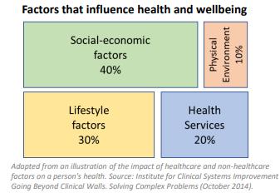
Integrated Care
Integration & Place – working with partners
Doing things differently – ‘left shift’
Personalised care, inequalities and prevention
Model of health determinants

Slide 11
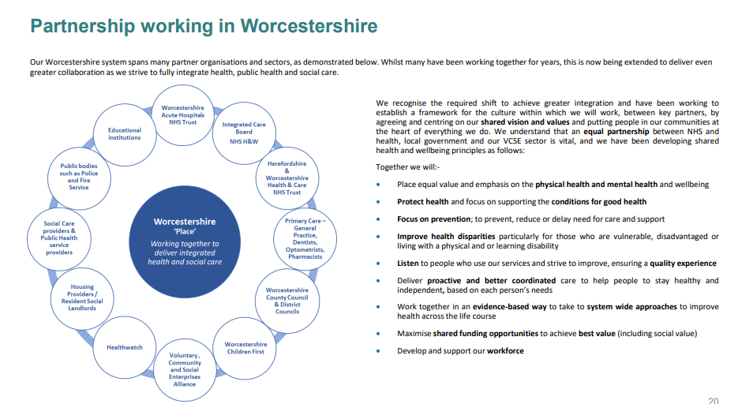

Slide 13
Neighbourhoods, Places and Systems
Neighbourhoods (covering populations of 30-50k people): where groups of GP practices work with NHS community services, social care and other providers to delivery more co-ordinated and proactive care.
Places (covering populations of 250-500k people): where partnerships of health and care organisations in a town or district – including local government, NHS providers, VCSE organisations, social care providers and others – come together to join up the planning and delivery of services, redesign care pathways, engage with local communities and address health inequalities and the social and economic determinants of health.
Systems (covering populations of around 500k to 3 million people): where health and care partners come together at scale to set overall system strategy, manage resources and performance, plan specialist services, and drive strategic improvements in areas such as workforce planning, digital infrastructure and estates.

Slide 14
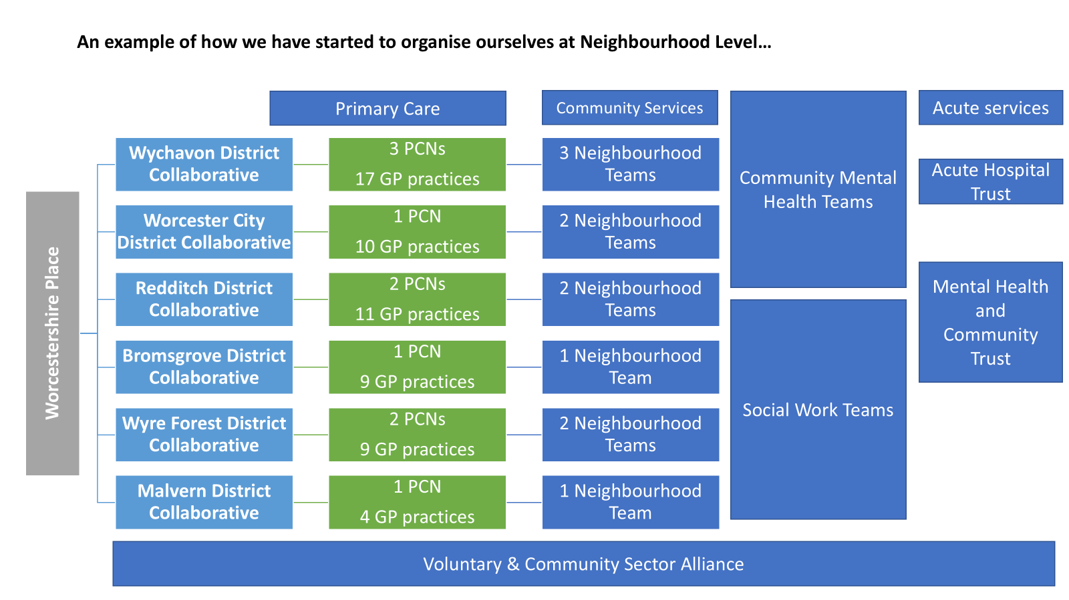

Slide 15
Intended Outcomes for Integrated Neighbourhood Teams – NHS England
Streamlining access to care and advice for people who get ill but only use health service infrequently, providing them with much more choice about how they access care and ensuring care is always available in their community when they need it.
Providing more proactive, personalised care with support from a multidisciplinary team of professionals to people with more complex needs, including, but not limited to, those with multiple long-term conditions.
Helping people to stay well for longer as part of a more ambitious and joined-up approach to prevention.
Move towards the “Team of teams” model promoted in Dr Fuller’s stocktake, these teams need to have the infrastructure support and multidisciplinary membership from diverse staff groups including the VCSE and social care.

Slide 16
Integrated Neighbourhood Teams Accelerator Sites
Proactive, personalised and preventative care delivered by integrated neighbourhood teams is at the heart of the vision set out by the Fuller Stocktake. This is also likely to form a central part of the new NHS 10 Year Plan, which is due to be published by the Government next year.
Patients, communities and the contribution of voluntary, community and social enterprises all play an important role, alongside health and social services, in shaping the model.
The 3–5-year programme begins with the identification of a number of integrated neighbourhood team (INT) accelerator sites, to determine if a blueprint INT model can be established and then rolled out during 2025/26.
Five primary care networks (PCNs) in Worcestershire, who met the criteria agreed by the Worcestershire Integrated Primary & Community Services Steering Group, submitted an expression of interest. Three of these were supported to become INT accelerator sites: • Worcester City PCN • Kingfisher PCN (Redditch) • Wyre Forest Health Partnership
Each site will focus on a particular cohort of patients ranging from severe frailty, diabetes and heart failure.
An introduction day for the three sites is planned for 1 October 2024. The pilot will last for 8 months.

Slide 17
District Collaboratives
District Collaboratives bring together statutory health and care services, District Councils, the VCSE, and wider partners to deliver against shared priorities for their communities.
This way of working and represents a shift in how communities and health and care providers work together. This should see greater local autonomy and resources directed into communities to enable greater control over addressing the underlying causes of ill health through interventions people design for themselves.
There is a focus upon building strong, resilient communities, understanding and being able to optimise local assets, whilst articulating gaps and opportunities available to further improve the local offer.
We are increasingly seeing that local partnerships are most effective in improving population health and tackling health inequalities.

Slide 18
Provider Collaborative and Worcestershire Place Parternship
Provider Collaborative
Worcestershire Acute, H&W Health and Care Trust and Primary Care – with ICB support
Initial clinical discussions considered potential development of Virtual Wards for frailty, COPD/respiratory & diabetes
Next stage – development of services involving wider system involvement
Worcestershire Place Partnership
Membership – leaders from all ICS partner organisations
Group providers leadership for, and delivery of, agreed programmes of work identified as Worcestershire Place priorities
Amanda Killroy and Esther Passingham – VCSE representatives
October workshop to agree Place priorities and develop implementation plan – what we’re doing and how we’re going to do it!

Slide 19
Next steps

Slide 20
Opportunities for partnership working
* Taken from report compiled on behalf of NHSE
Design and delivery of personalised, preventative services VCSE organisations are key partners in the provision of personalised care pathways and prevention based on the wider determinants of health of local people. They are providers and facilitators of knowledge, training and engagement to PCNs on their communities and are vital to influencing and delivering of sustainable social prescribing strategies.
Provision and sharing of community spaces The 2022 Fuller Stocktake report on the next steps for integrating primary care highlights the need to make use of VCSE spaces and community assets. These spaces are well placed to host co-located primary care services and are crucial for the social connection necessary to prevent isolation and the worsening of mental health requiring clinical support.
Community engagement and insight VCSE organisations are key partners in facilitating community engagement, research and insight. Through trusted staff and within trusted, accessible spaces, this can support the co-creation of asset-based approaches to support those most affected by health inequalities.
Workforce integration VCSE staff can play a key role in the local health and care workforce as part of integrated neighbourhood teams. This can support the achievement of shared local goals by bringing together the widest range of practitioners supporting individuals with both the clinical and wider determinants of their health.

Slide 21
Factors for success
* Taken from report compiled on behalf of NHSE
Leadership and culture – effective collaboration requires committed drivers and leadership to build a positive, trusting working culture. This means health partners understanding that VCSE organisations can, will, and probably already are delivering high quality services that are keeping local people well.
Collaboration and communication – local forums and provider collaboratives, in which VCSE organisations are included, can be a strong tool for making collaboration happen.
Mutual capacity and capability building – increasing skills, capability and capacity for community development approaches increases the ability to work constructively with the VCSE sector, communities and other partners like local government.
Local flexibility – there must be a recognition that there is no one-size-fits-all approach.
Data sharing and impact monitoring – there is a need for shared data on population health, local wider health determinants and patient records to help integrated neighbourhood teams work effectively. These require shared systems and data-sharing agreements for VCSE insight and public health data to ensure priorities, strategies and services are fully informed and locally driven.

Slide 22
How are we doing?
NHSE Annual assessment letter to H&W ICB
The feedback is positive, emphasising in particular:
Effective system leadership and collaboration with partners
Significant progress the ICB has made in delivering operating plan trajectories and priorities with an obvious commitment to continuous improvement
NHSE’s confidence in the ICB’s approach to reducing inequalities
Acknowledgement that the ICB has demonstrated good capability and competence within the finance function
Effective oversight and governance
The ambition of the ICB to support boarder social and economic development, with the ICB making progress to becoming an anchor institution.
Areas of improvement which were identified, focused on delivery of operational priorities and improving the system’s financial position.

Slide 23
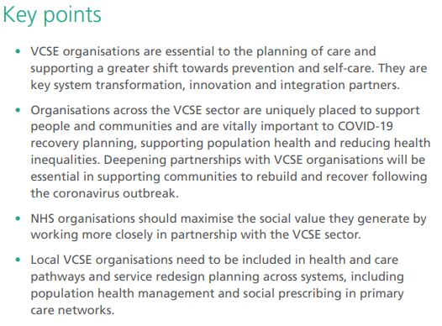
Partnership working
NHS Confederation report

Slide 24
NHSE ICS Design Framework
The VCSE sector is a vital cornerstone of a progressive health and care system. ICSs should ensure their governance and decision-making arrangements support close working with the sector as a strategic partner in shaping, improving and delivering services and developing and delivering plans to tackle the wider determinants of health.
VCSE partnership should be embedded as an essential part of how the system operates at all levels.
This will include involving the sector in governance structures and system workforce, population health management and service redesign work, leadership and organisational development plans.

Slide 25
Further information
NHS England » Voluntary, community and social enterprises (VCSE)
NHS England » A framework for addressing practical barriers to integration of VCSE organisations in integrated care systems
Thriving places – Guidance on the development of place-based partnerships as part of statutory integrated care systems: ICS-implementation-guidance-on-thriving (england.nhs.uk)
How-health-and-care-systems-can-work-better-VCSE.pdf (nhsconfed.org)
NHS Herefordshire and Worcestershire Integrated Care Board: Annual_Report_and_Accounts_2023-24.pdf (hwics.org.uk)
Integrated Care Systems Explained | The King's Fund (kingsfund.org.uk)
Working in Partnership with the Voluntary Community and Social Enterprise Sector - FutureNHS Collaboration Platform
Healthy Places And Communities | The King's Fund (kingsfund.org.uk)
Joint Strategic Needs Assessment (JSNA) | Worcestershire County Council
Herefordshire and Worcestershire Integrated Care Strategy 2023-2033: PowerPoint Presentation (hwics.org.uk)
The Fuller Report: Microsoft Word - FINAL 003 250522 - Fuller report[46].docx (england.nhs.uk)
FutureNHS: Locality The VCSE sector in prevention and primary care July 2024 - Working in Partnership with the Voluntary Community and Social Enterprise Sector - FutureNHS Collaboration Platform

Slide 26
Thank you

