Slide 1

Understanding and Strengthening the VCSE Sector in Worcestershire
An Alliance Project funded by Worcestershire County Council
Dr. Catharine Rose, Research Fellow – University of Worcester
Peter Rose, Director – Tiller Research Ltd

Slide 2
Overview
Building an evidence-based understanding of the VCSE Sector in Worcestershire
Phase One: Mapping (March 2024)
Phase Two: Questionnaire Research (September 2024)
Phase Three: Qualitative Research (March 2025)

Slide 3
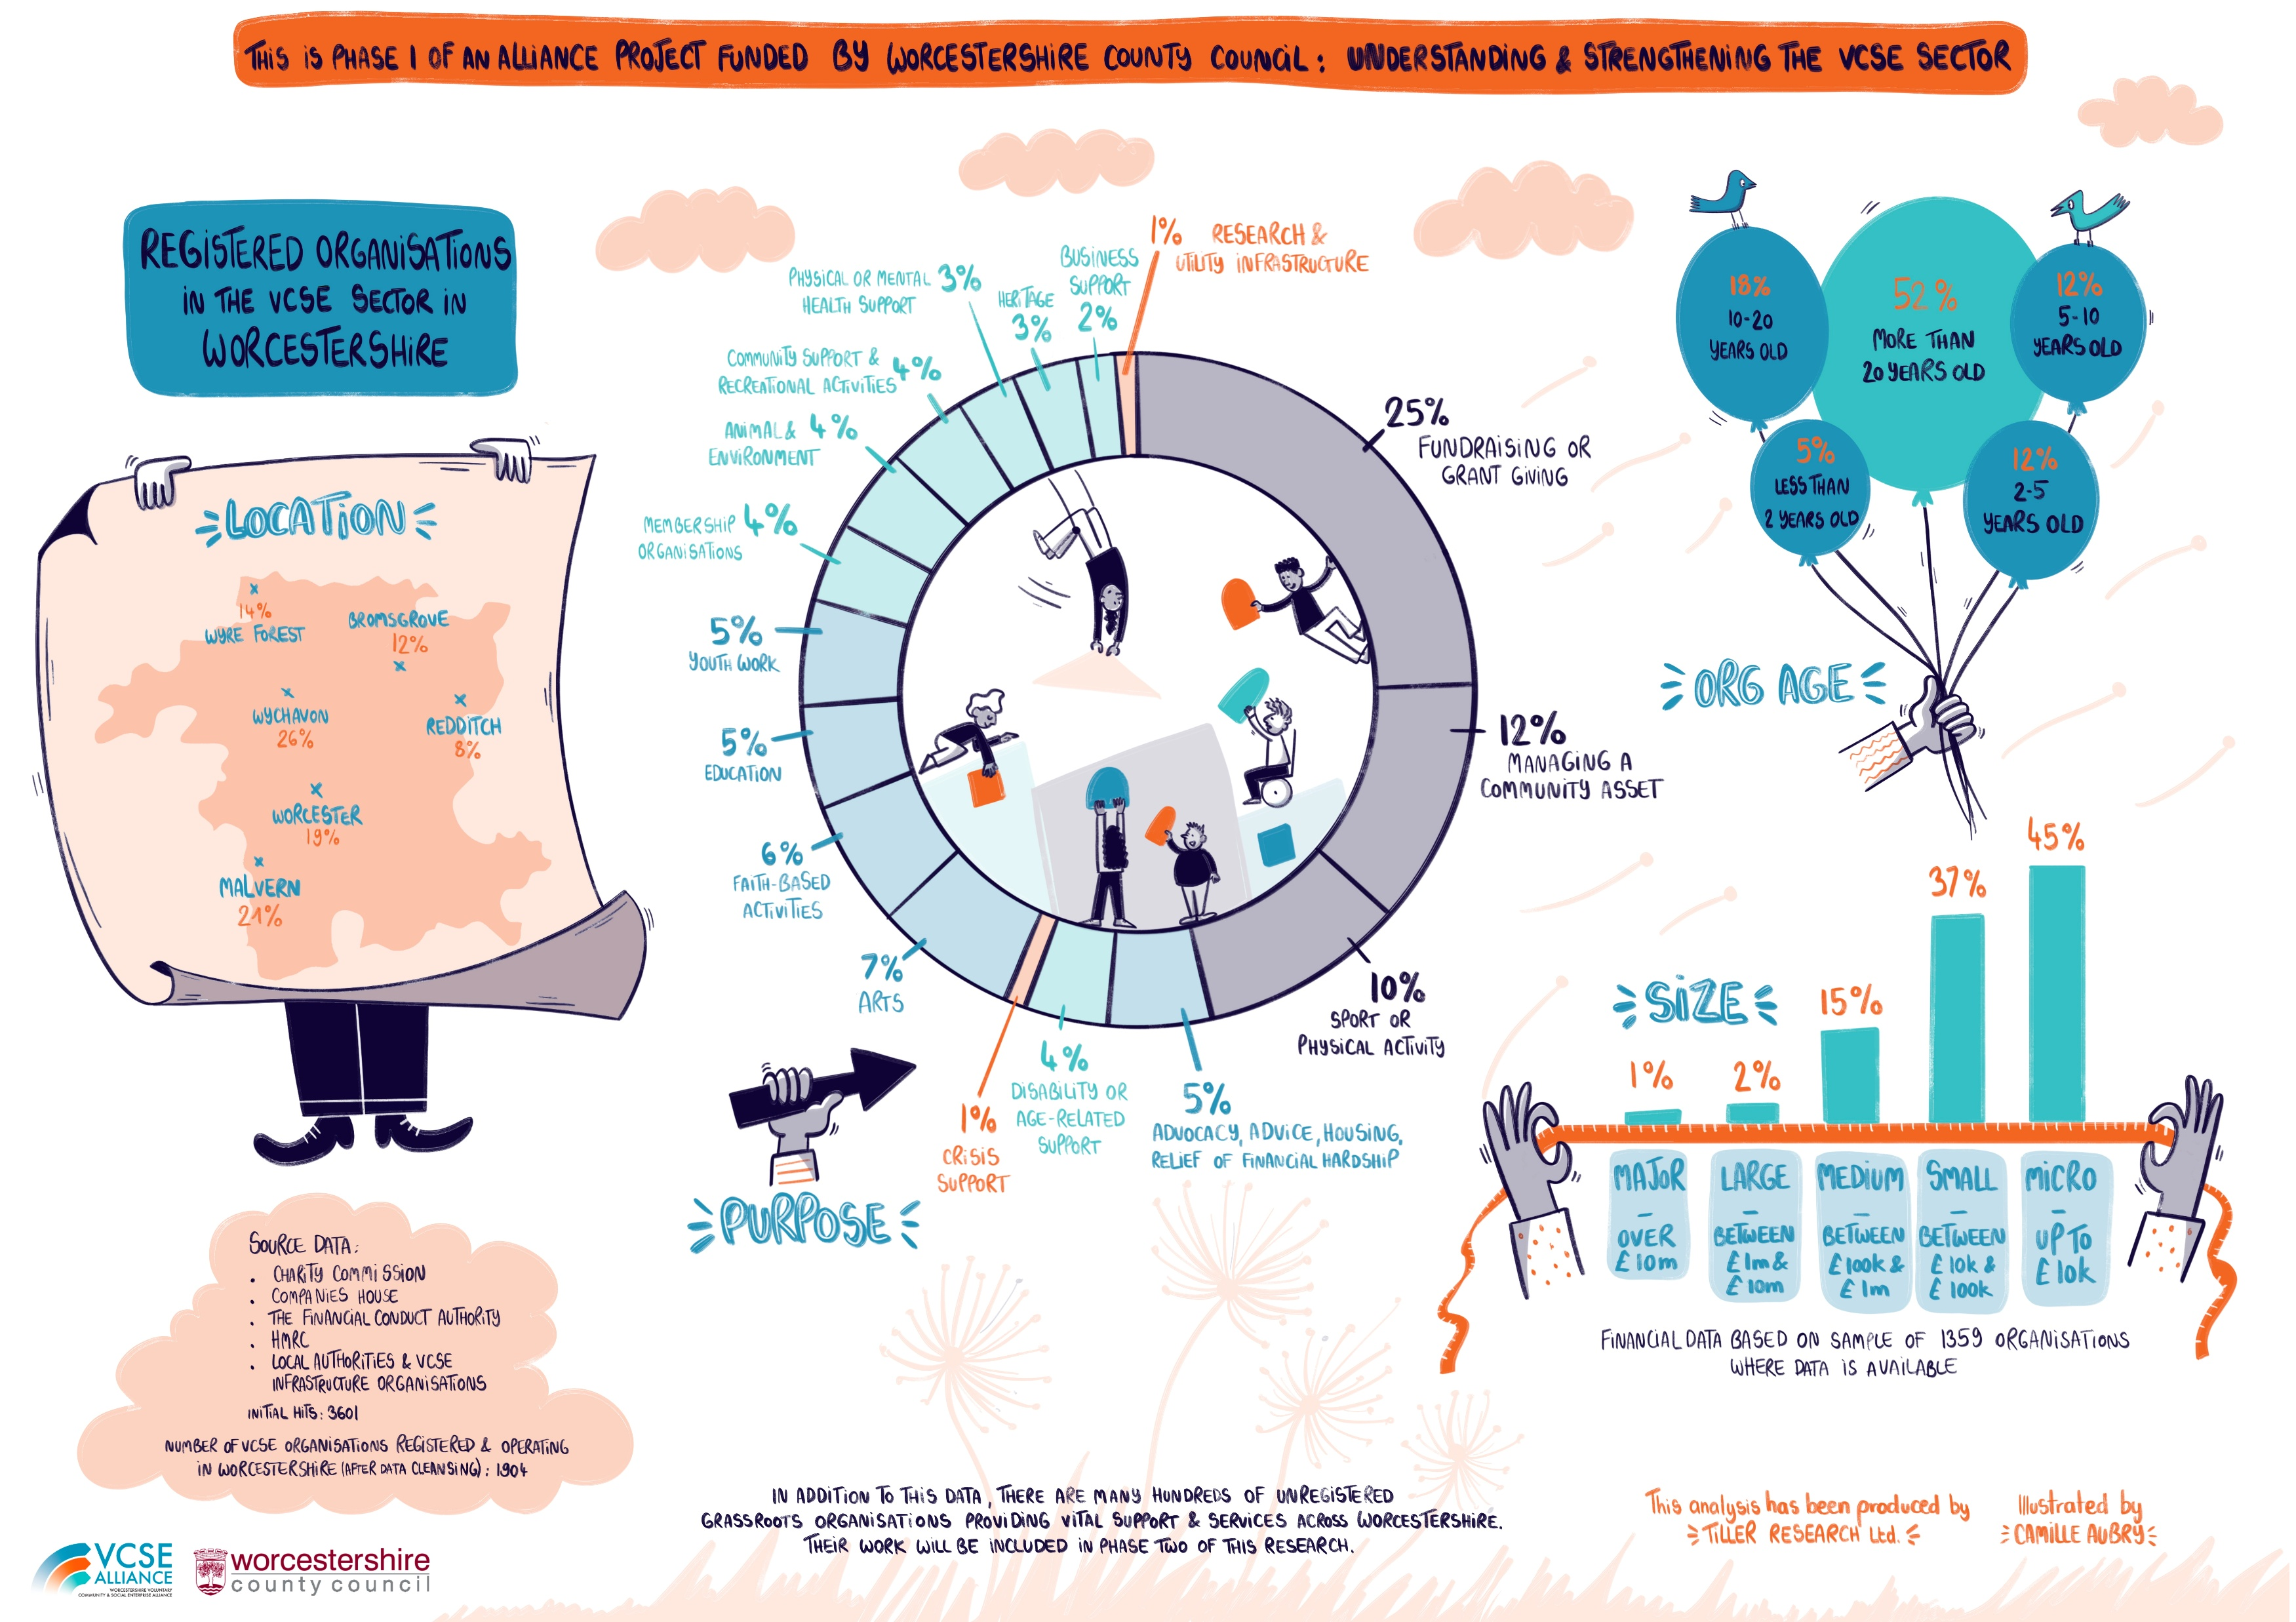
Phase One:

Slide 4
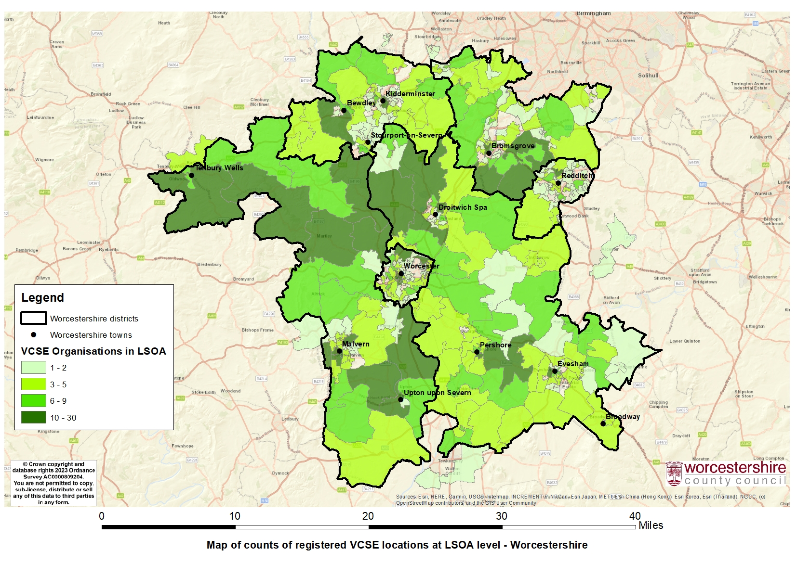
Phase One:

Slide 5
Phase Two: Questionnaire Research
Online survey, with usable data from 179 representatives of VCSE organisations working in Worcestershire
A mix of quantitative and qualitative data
Sample of respondents had a broadly similar profile to the Phase One results

Slide 6

Outputs:
Responses were used to inform Phase 3
Results from Phases 2 & 3 will be presented across six thematic reports
Report 2 outlines the quantitative results
  Today’s forum will identify recommendations
  in response to the findings of the U&S Research to conclude the thematic reports

Slide 7
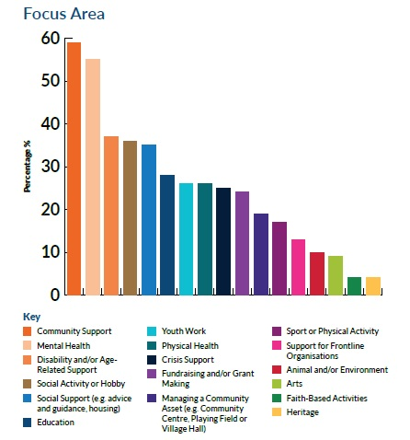
Key Points:
89% of organisations report delivering activities in more than one impact area
51% of organisations report delivering activities in four or more impact areas

Slide 8
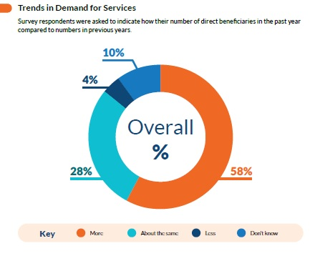
Key Points:
58% of respondents indicated increasing demand
  Increased mental health needs
  More complex needs
  Increased loneliness
  Cost of living
  Impact of stretched public services

Slide 9
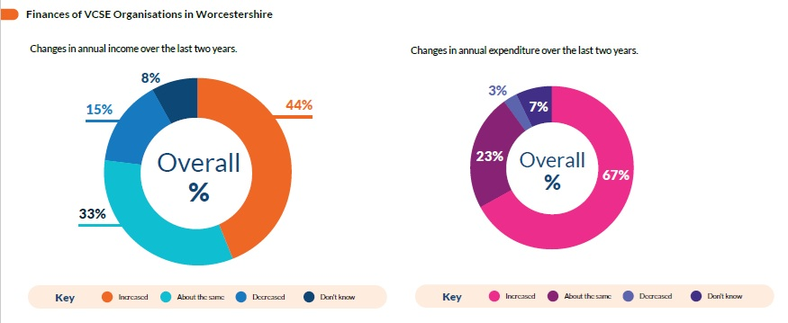
Typically, income has increased- but expenditure has increased more
  A third of respondents reported reductions in reserves
  Financial pressures broadly related to organisation size

Slide 10
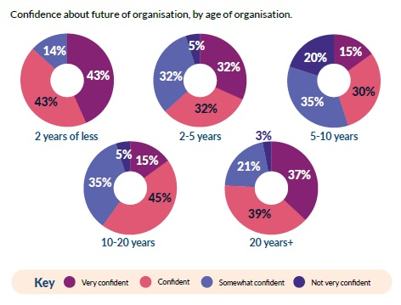
Confidence about the future is reasonably strong, but a significant minority have low confidence…
  Larger organisations typically more confident about the future of their organisation than smaller organisations
  Confidence is highest for very young (<2years) and well-established (20+ years) organisations

Slide 11
Key Points:
There is no single picture of the scope, opportunities and challenges for VCSE organisations in Worcestershire
Organisation size, measured by income, is frequently a key variable in understanding these differences
To ‘understand the sector’, it is necessary to recognise its diversity and embrace its complexity

Slide 12
Phase 3: Understanding and Strengthening the VCSE in Worcestershire: A qualitative study
Authors:
Dr. Catharine Rose, Research Fellow
Jess Howdle, MSc Research Associate
Prof. Eleanor Bradley, College Director of Research and Knowledge Exchange

Slide 13
Research methods and response
Research Aims: To build a comprehensive picture of the Worcestershire VCSE sector landscape through interviews and focus groups.
Data collection:
  between 28th November 2024 and 17th February 2025
  Interviews: online or face-to-face format
  Focus groups: online
Key questions:
Asked to describe the landscape of current VCSE services in their area
Strengths of the local sector
Current issues
Opportunities (current and emerging), and areas for development
Gaps in services and impact on communities.
  Participants:
  60 participants in total
  7 focus groups (n=29). One for each district, except for Bromsgrove
  31 individuals interviewed. Covering all districts and organisations working countywide.

Slide 14
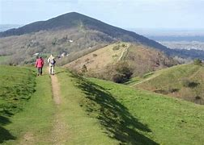

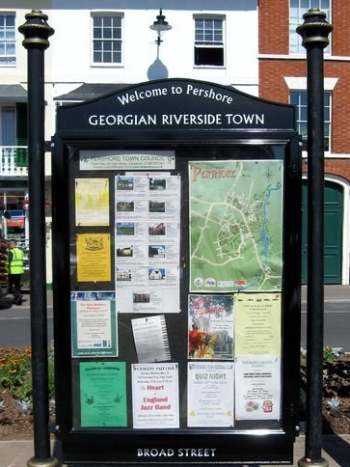
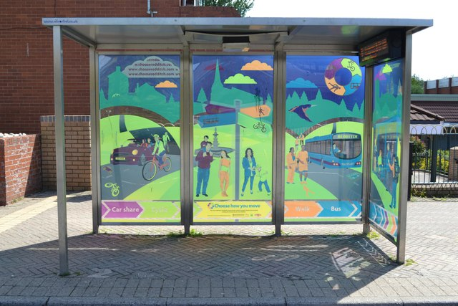
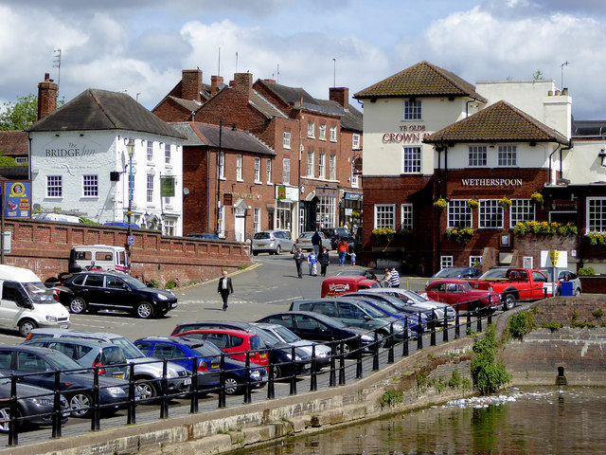
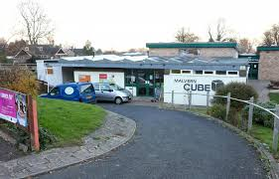
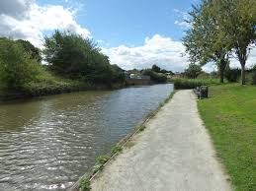
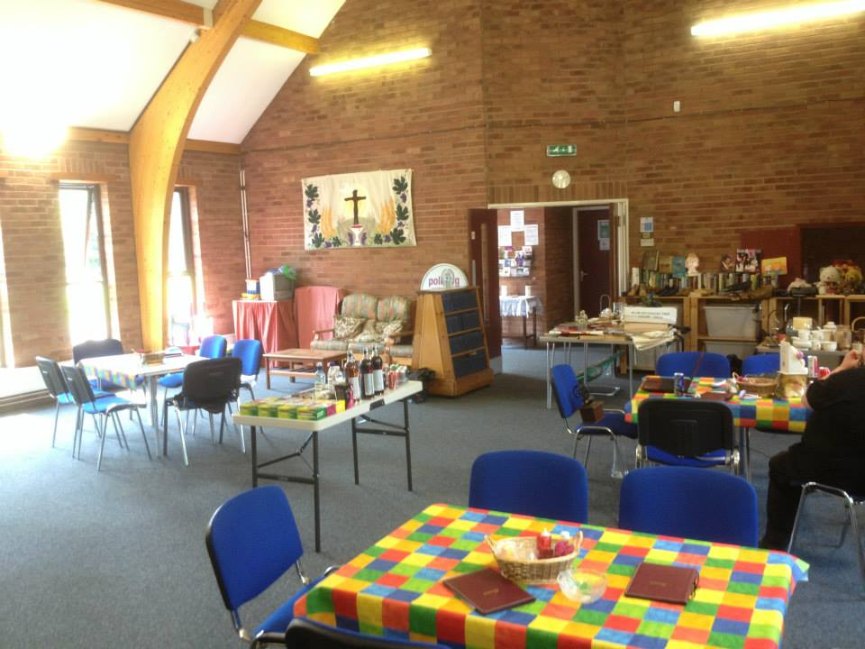
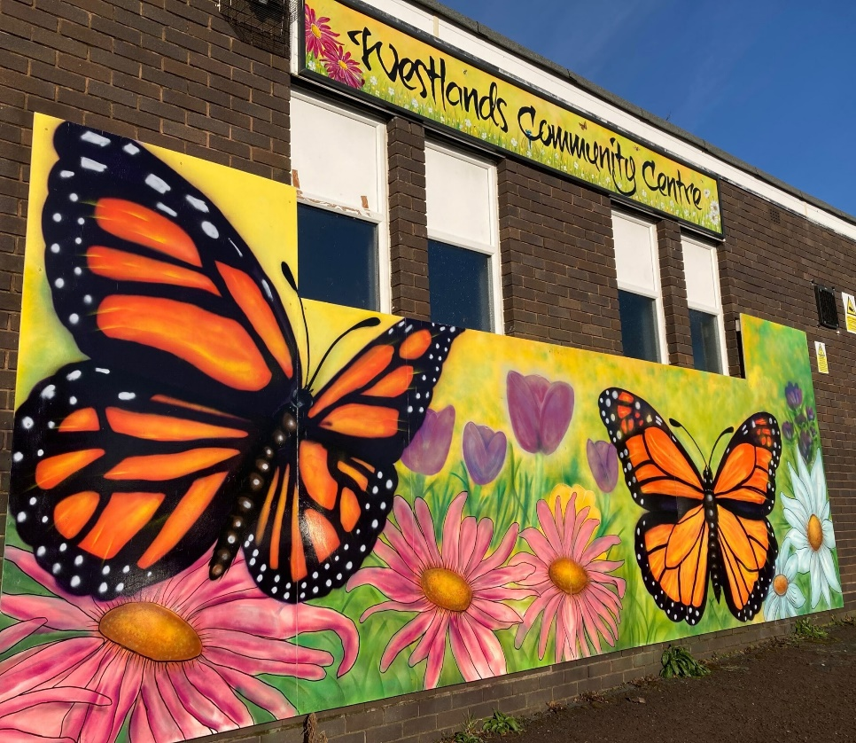
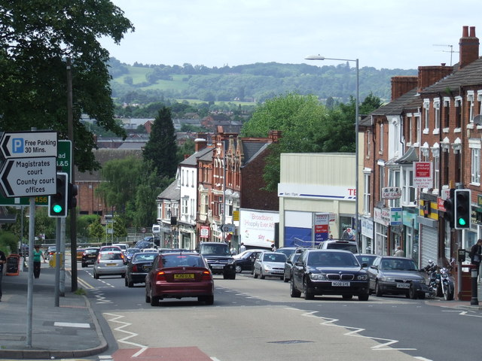
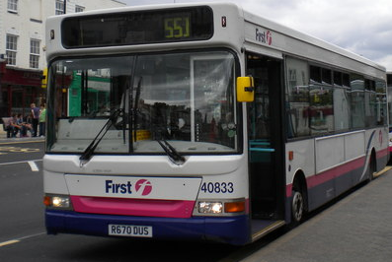
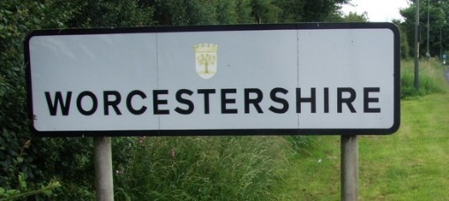
Findings: Perspective of the Worcestershire sector on the local VCSE landscape
  University of Worcester. April 2025.

Slide 15
Five themes
Theme 1: Strengths of the sector, and opportunities for development and growth
Theme 2: Gaps in the provision of local services for communities
Theme 3: Challenges for VSCE organisations
Theme 4: Changes and Resources to support the VCSE sector
Theme 5: Relationship of the VCSE with the public sector

Slide 16
Theme 1: Strengths and Opportunities for the VCSE in Worcestershire
Strengths and Opportunities
Opportunities:
Sharing knowledge
Pooling resources
VCSE Alliance – can facilitate collaboration, knowledge-sharing, and resource-sharing.
Public sector investment in the VCSE could reduce pressure on public services and provide place-based expertise.
Co-production.
Collaborative funding applications
Working with the private sector
Strengths
Combined, countywide coverage addressing most areas of community needs.
Deep knowledge of communities
Expertise in working with local people, often with complex needs
Communities trust the VCSE
Agility
Cost-effectiveness
Creativity
Resilience

Slide 17
Theme 2: Gaps in the provision of services for communities
Gaps in the provision of services for communities
Gaps in local services increase demand and reduce capacity for VCSE support.
Gaps:
- Health services
- Mental health (all levels).
- Co-morbid mental health and substance misuse
- Suicide-prevention and bereavement
- Socially-isolated residents
- Minority ethnic groups (including free English-language lessons)
- LGBTQ+ population.
- Youth work
- Free life-skills support (e.g. cooking, budgeting).
Accessibility
- Lack of public and community transport
- Patchy coverage across the County
- Unaffordable fares
- Inaccessible vehicles/ stations
- Digital exclusion (e.g. lack of physical information and face-to-face support)
- Lack of support workers

Slide 18
Theme 3: Challenges for VCSE organisations
Challenges for VCSE organisations
Financial pressures:
- Obtaining funding, bid writing
- Lack of longer-term funding opportunities
- Rising cost of living
- Short-term contracts, low pay, job insecurity.
- Lack of resources for staff development and support
- Concern about the impact of the move to a Unitary Local Authority on financial position.
Meeting communities’ needs:
- Increase in residents needing support
- Increase in residents with complex and multiple needs
- Reduced time to develop services or network with other organisations
Factors creating gaps in VCSE service delivery
- Funding
- Infrastructure (e.g. support for staff and volunteers)
- Training and support, including for governance
- Duplication and lack of collaboration with other groups
- Strategic plans and frameworks not being implemented at the grassroots level (often down to lack of capacity)

Slide 19
Theme 4: Changes and Resources to support the VCSE
Changes and resources to support the VCSE
-
Increased recognition, recruitment and support of volunteers:
- Recruitment is becoming more difficult. Changing trends in volunteering (e.g. opportunities that people want, availability).
- Skills gaps (e.g. social skills, office skills).
- Some organisations are not / less connected to the VCSE infrastructure
- Lack of resources to train and develop volunteers
- Interest in working with other VCSE organisations to pool volunteer support, training and development resources
Support with management, training and staff development:
- Common areas where support is needed include: legal, governance, HR, financial, business planning, fundraising.
- Specialist staff training (e.g. rape crisis; youth work; safeguarding).
- Training for back-office staff (e.g. MS Office; book-keeping).
Increased recognition of the impact made by the VCSE sector
- Draw on VCSE expertise
- Provide stable funding to allow VCSE to develop and grow
- Provide funding to support increased public sector recommendations and referrals
Confidence to challenge the public sector
- to challenge decisions taken by the public sector from the perspective of the VCSE’s expertise and local insight.
- VCSE often trusted more by communities

Slide 20
Theme 5: Relationship with the public sector
Relationship with the public sector
Demands made without the provision of additional resources:
- Some organisations reported that public sector organisations asked for their input or referred clients to them, but provided no additional resources.
- Suggestions that the public sector could share its own resources with VCSE workers (e.g. internal training, physical space, equipment, services).
Lack of recognition and involvement
- Excluding the VCSE from the design of new services or strategic plans.
- Tendency of public sector to ‘reinvent the wheel’, rather than building on VCSE-driven work that is already running.
A relationship defined by an imbalance
- Not treated as partners
- Expertise not recognised
- Track record of success not acknowledged
- Precarious relationship that is often dependent on a particular officer or funding streams.

Slide 21
Researchers’ reflections on the conversations
VCSE organisations’ passion for and commitment to local communities shone through.
Demonstrated their expertise in local communities and issues.
Appetite for increased collaboration, particularly in terms of sharing knowledge, resources and funding bids.
The majority were enthusiastic about the potential benefits of the VCSE Alliance, specifically in terms of facilitating collaboration, networking and developing a knowledge-base about the activity of the sector. Issues were raised about the time and resources required for networking and attending events, and smaller organisations feel disadvantaged here. Disappointment when events or meetings are cancelled.
Enthusiasm for taking part in Phase 3. In several district focus groups, participants valued the opportunity to get to know other organisations working in their district that they were unaware of or had not had the opportunity to meet, and participants often shared information and contact details.

